Slide 1
React under the hood
Author: HaiPham

Slide 2
Outline
DOM
HTML
What and How react.js works?
Why React.js?
Common library to use?

Slide 3
1. DOM

Slide 4
2. HTML

Slide 5
3. What and How react.js works?
From html to react.js
Compare formal javascript and react.js
React components
How to create and import components

Slide 6
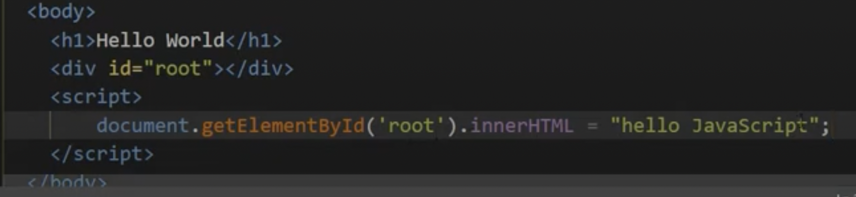
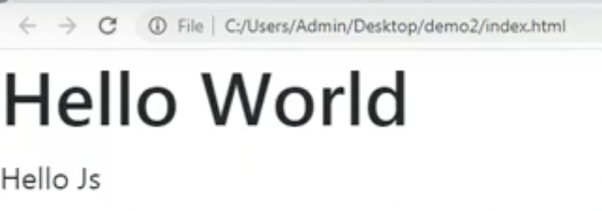
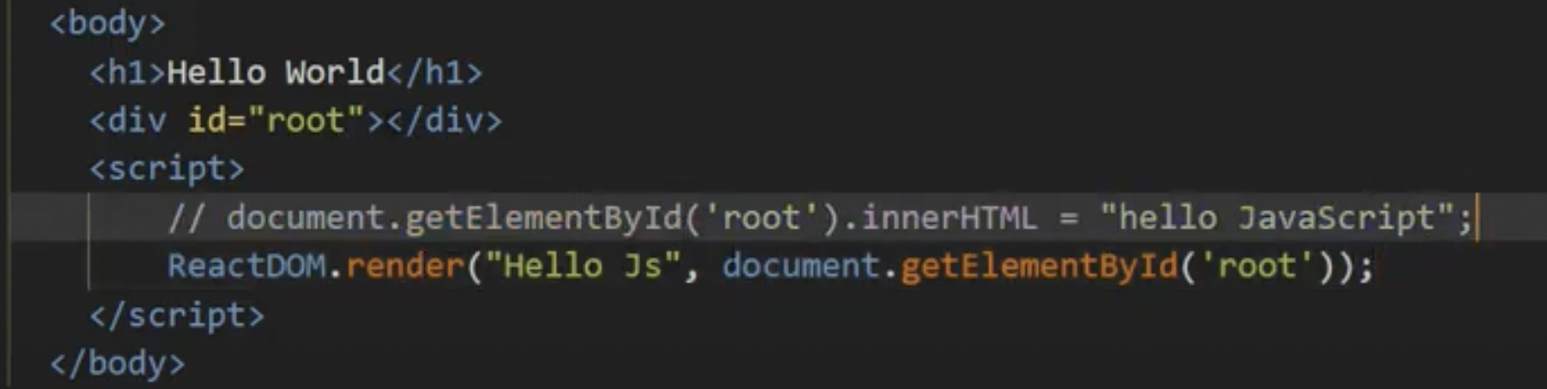
3.1 From html to react.js

Slide 7
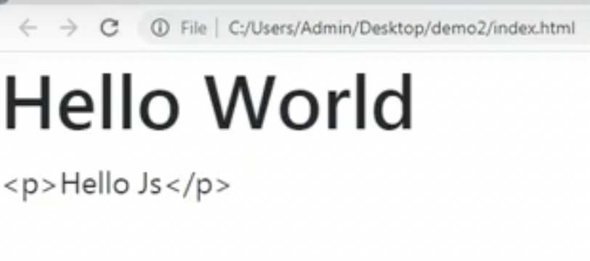
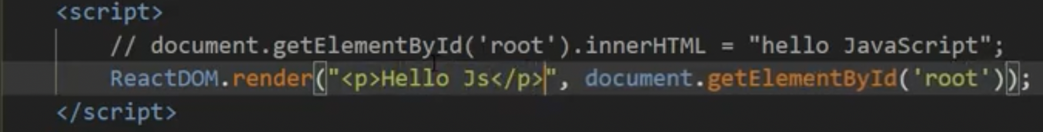
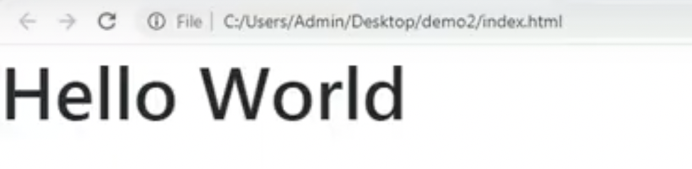
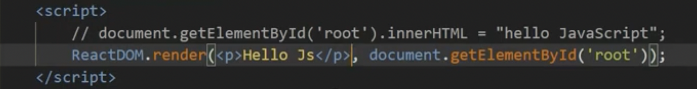
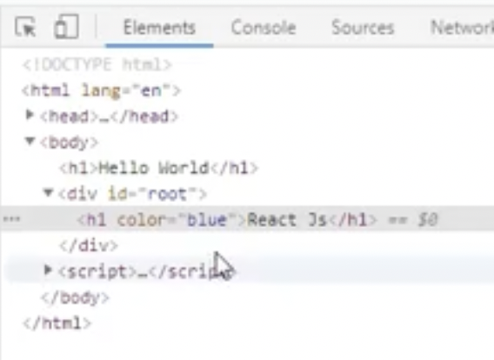
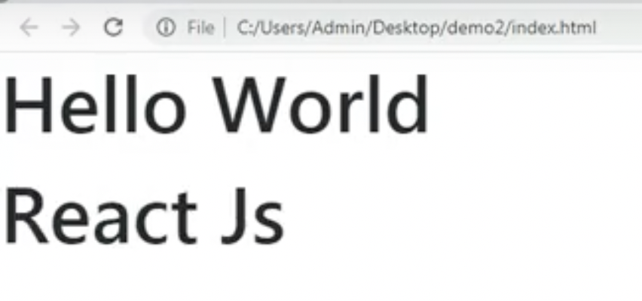
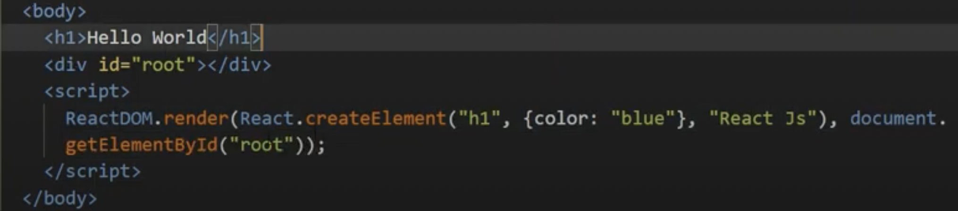
3.1 From html to react.js

Slide 8
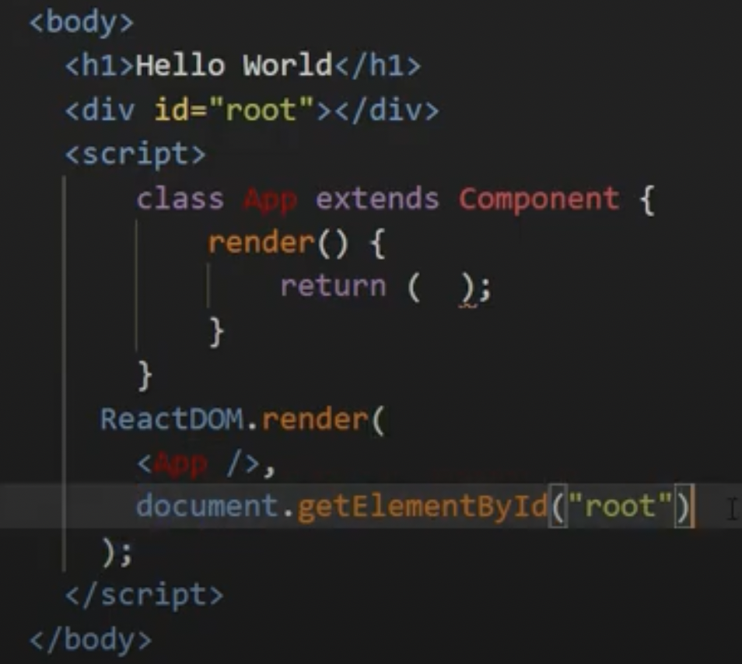
3.1 From html to react.js

Slide 9
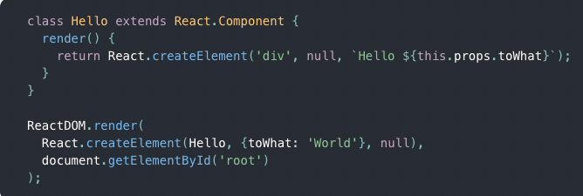
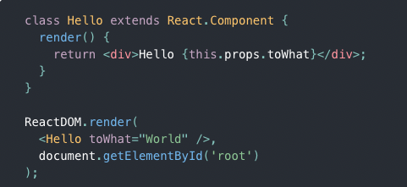
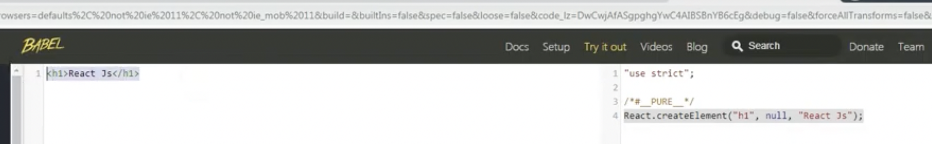
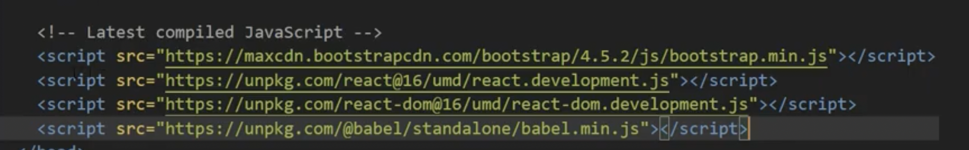
3.2 JSX and NONE JSX
SAME RESULT DIFFERRENT
STYLE
Babel is comming
SET UP

Slide 10
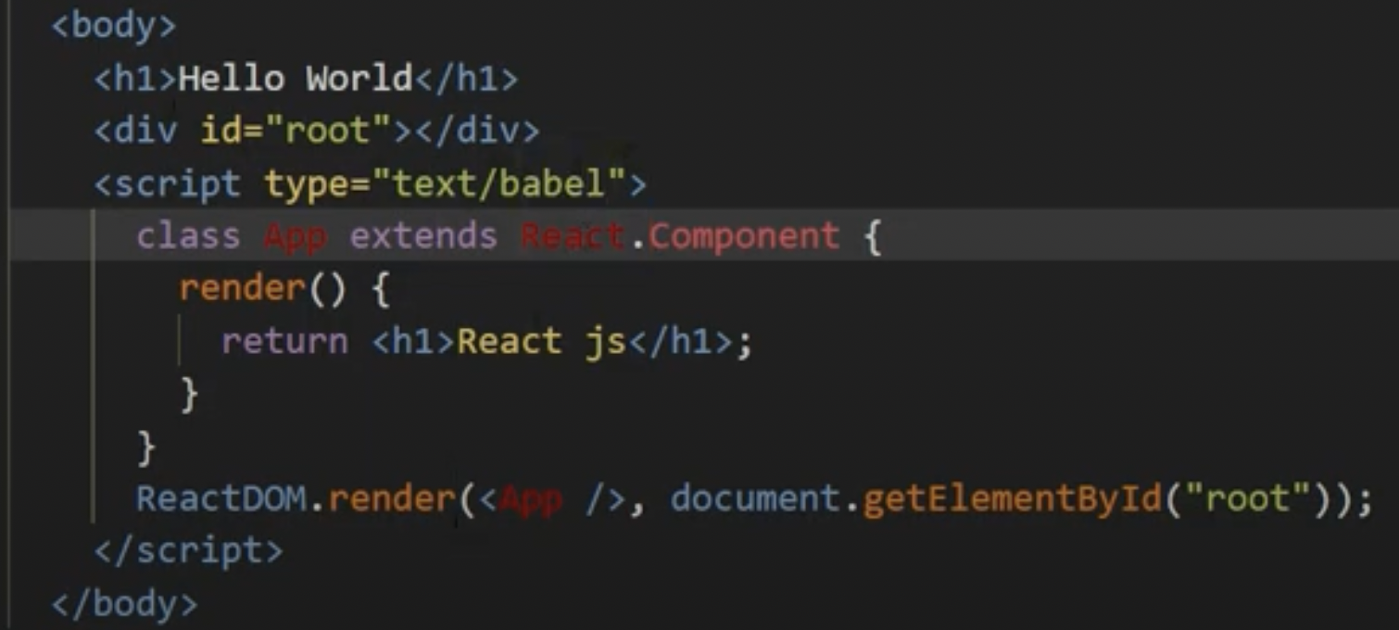
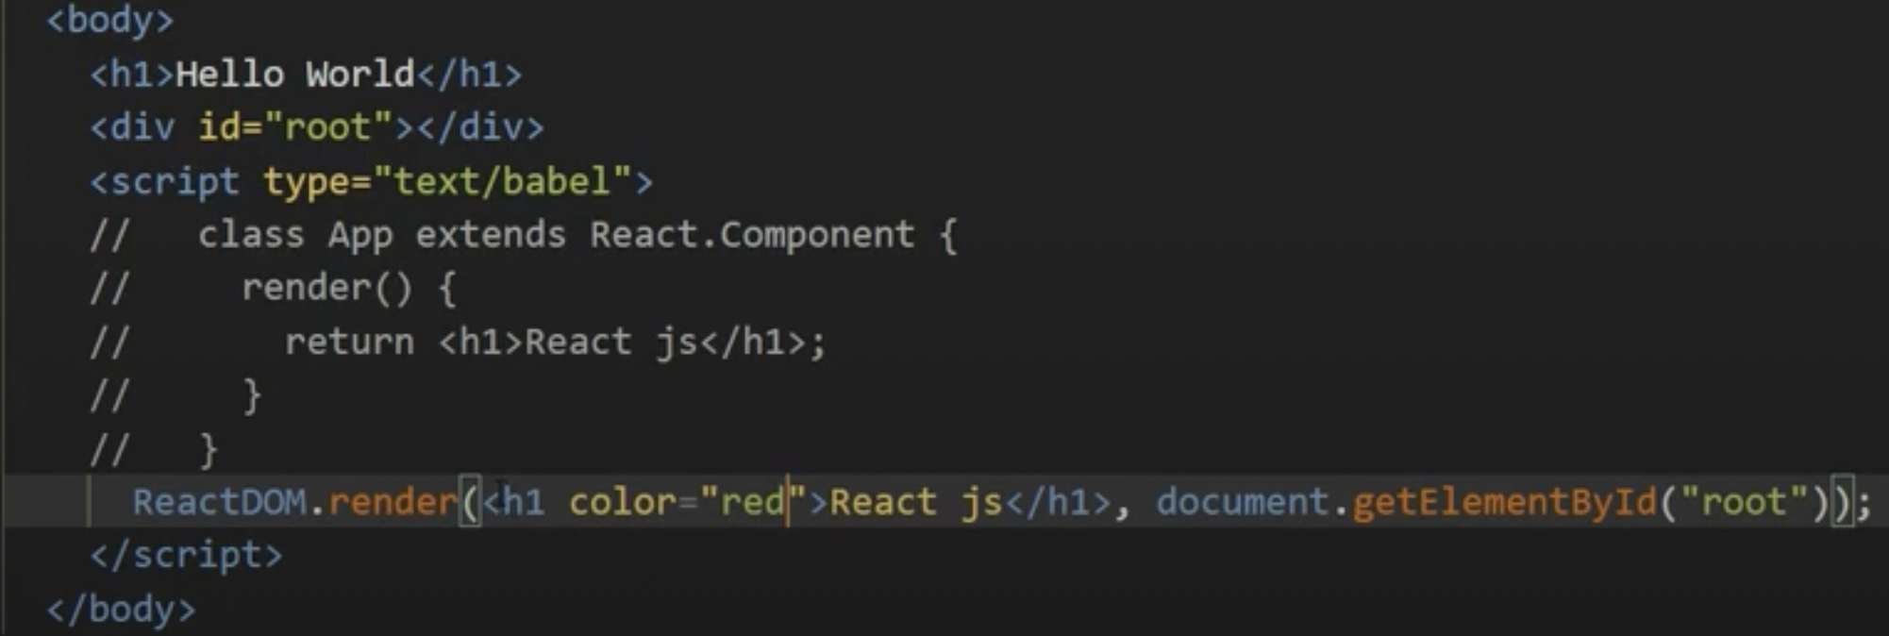
3.2 JSX and NONE JSX

Slide 11
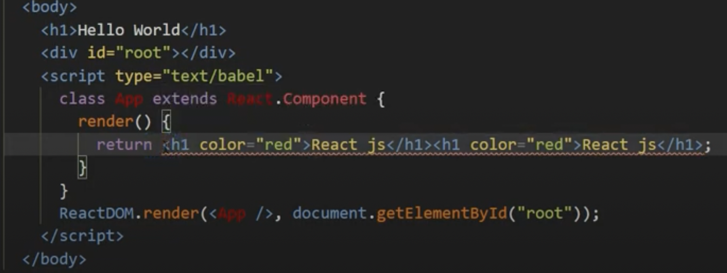
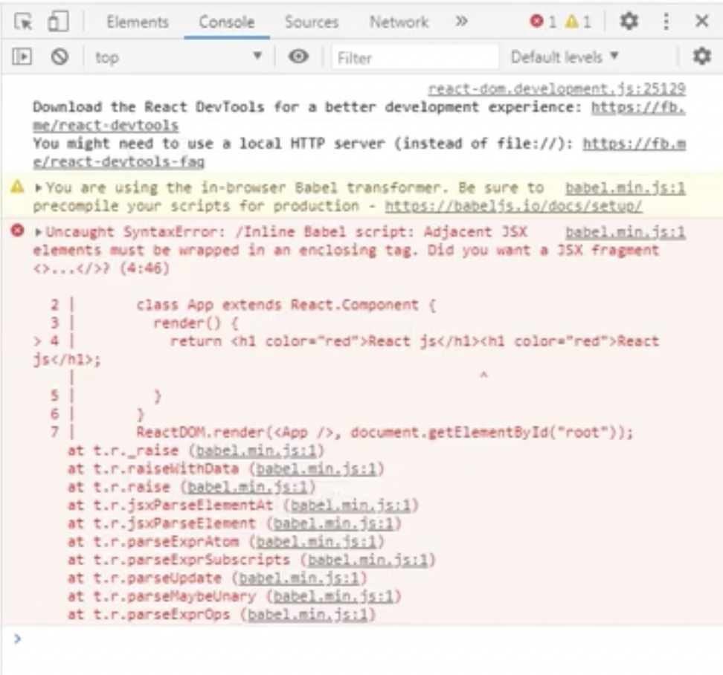
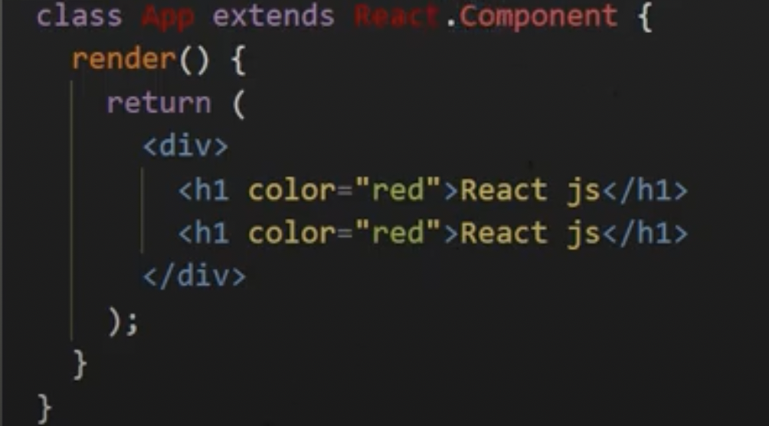

Slide 12
3.2 What JSX
From html to react.js

Slide 13
4. Why react.js

Slide 14
5. Common library to use?
Ant

Slide 15
Referrences
Ant Design
Material-UI (MU) by Google

Slide 16
Thank you…!

